Slide 1
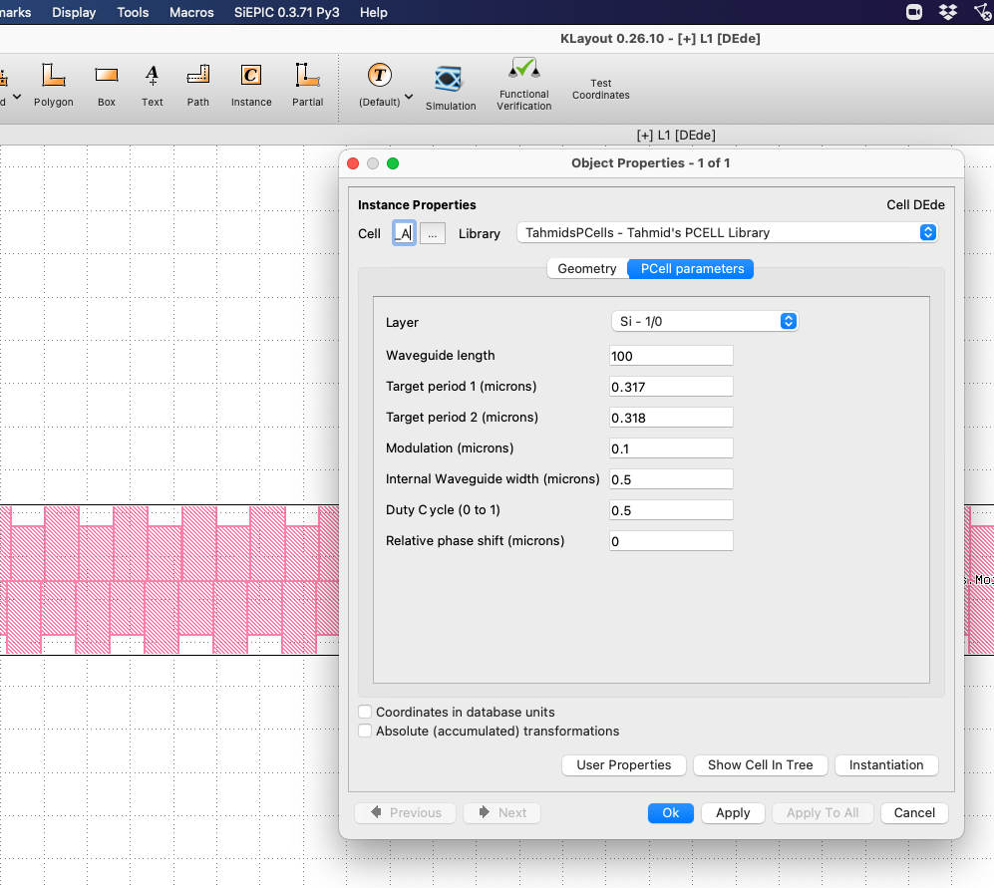
Moire Type A PCELL
All features:
length
Period1, period2
Duty cycle
Phase shift
Tahmid H Talukdar
Feb 2, 2022

Slide 2
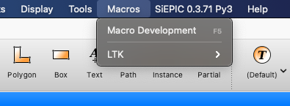
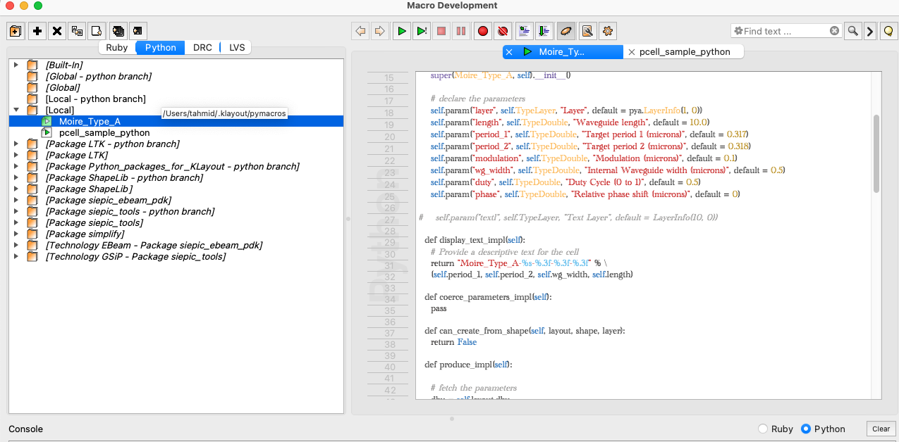
Instructions
Code available here:
https://github.com/tahmidhassan/PCells/blob/main/Moire_Type_A.lym
Or paste code here
Copy file here

Slide 3
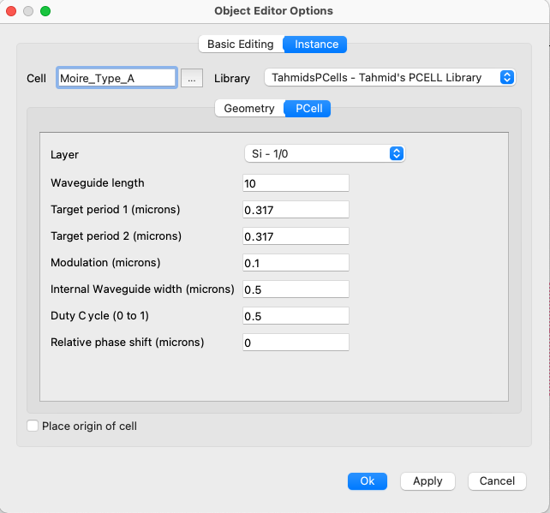
Restart KLayout
Find Pcell Instance here

